Slide 1
Job Market Analysis and Skill Gap Identification
“Skills needed to be successful in data science and Ai engineering carrier”

Slide 2
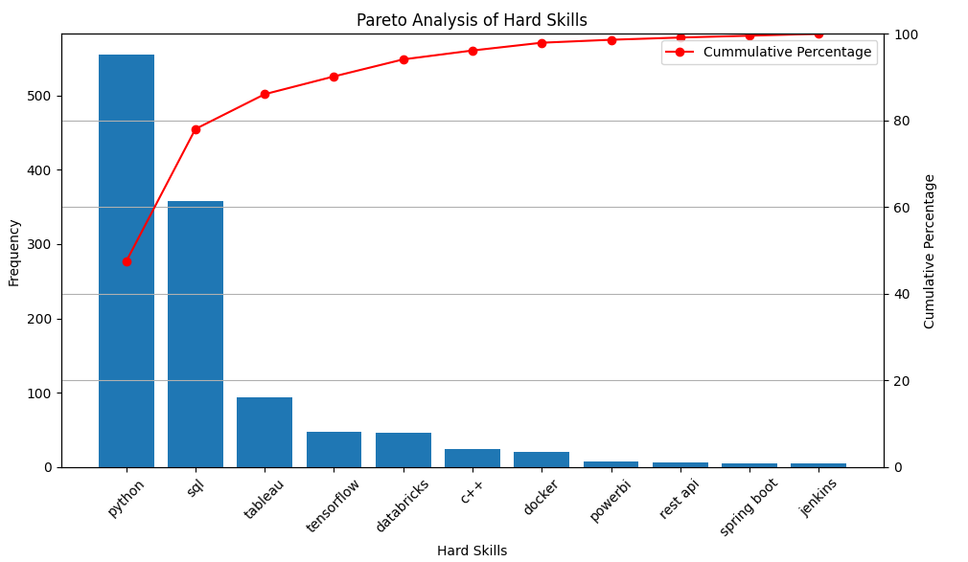
Findings
The skills identified in the analysis are crucial for individuals pursuing careers in data science and AI engineering
According to the Pareto analysis, Python and SQL are particularly important, collectively accounting for 80% of the most frequently mentioned skills in job listings.

Slide 3

Hypothesis
Tech industry companies prefer to hire employees who possess highly specialized skills relevant to data science and AI engineering.
The skills most frequently listed in job postings are essential for success in data science and AI engineering fields.
Emphasizing these key skills on resumes and during interview preparation significantly increases the likelihood of securing a job in the tech industry.

Slide 4
Experiment Setup
Downloaded 210 PDFs containing remote data science and AI engineering job listings from LinkedIn.
Extracted text content from each PDF document using Lang chain.
Utilized LLM (llama3-8b-8192) to extract hard skills from the text.
Counted the frequency of each skill extracted from the documents
Conducted Pareto analysis to identify the most critical hard skills based on their frequency.

Slide 5
Follow On Actions
Recommendations
Highlight Python and SQL on resumes and cover letters as these are the most frequently sought-after skills.
Skills like Tableau and TensorFlow are also valuable and should be considered for a well-rounded skill set
Next Steps
Apply this approach to other job roles within data science and AI.
Call on Actions
Use these findings to guide job applications and professional development.

Slide 6
Thank you
Presented by Yves Mfitumukiza Ndayisaba
Date: 10th June 2024

